Slide 1

Getting the OWASP Top Ten Right with ABAC and XACML
April 9, 2015
With Gunnar Peterson @oneraindrop
and
Gerry Gebel @ggebel

Slide 2

Agenda
Security Fast and Security Slow
OWASP Top Ten
3 Examples
More Efficient Authorization
Q&A

Slide 3

Roger Needham
“we systems people regarded the users, and any code they wrote, as the mortal enemies of us and of each other. We were like the police force in a violent slum.”
-Roger Needham

Slide 4
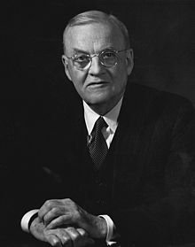
John Foster Dulles
“The measure of success is not whether you have a tough problem to deal with, but whether it is the same problem you had last year”
-John Foster Dulles

Slide 5

Groundhog day
“Why doesn’t the OWASP Top 10 ever change?”
-Chris Hoff (@Beaker)

Slide 6
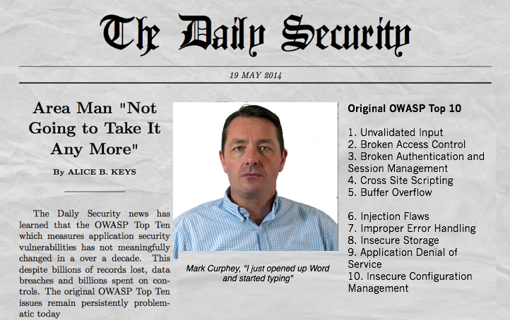

Slide 7
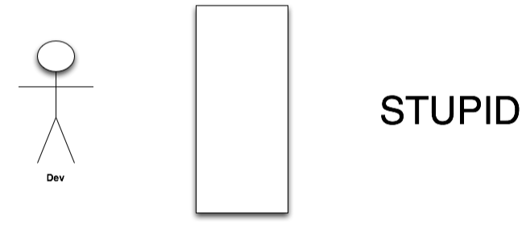
InfoSec

Slide 8
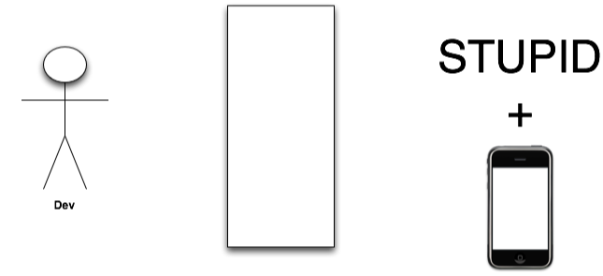
InfoSec

Slide 9

System 1 and System 2
System 1: Fast, intuitive, frequent, emotional, subconscious
2 + 2 = ?
System 2: Slow, effortful, infrequent, logical, calculating, conscious
18 x 23 = ?

Slide 10

System 1

Slide 11

System 2

Slide 12
System 1
What’s the capital of France?
Associative memory, you do not have to decide, it just happens. Like seeing that someone’s hair is dark
You are conscious of the results and your impressions, not how it happens

Slide 13
System 2
Two functions
Laborious, effortful. Compute things – what is 24 x 17?
Supervisor function. Can trigger System 2 processes. Best case – it should be the error correction function, recognizing when you are prone to error

Slide 14
Why should you care
In a nutshell-
System 1 usually wins!
When people are offered life insurance in two forms:
Life insurance that pays your heirs if you die in any event, or..
Life insurance that pays your heirs in the event you die in an act of terrorism
People are more likely to choose the second plan.
Simply making rational arguments isn’t good enough

Slide 15
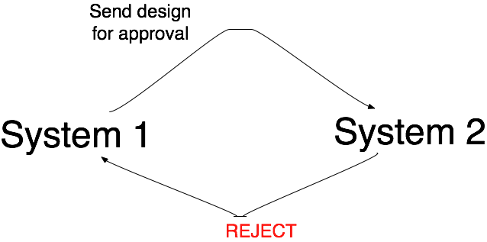
Stuck In a Loop

Slide 16
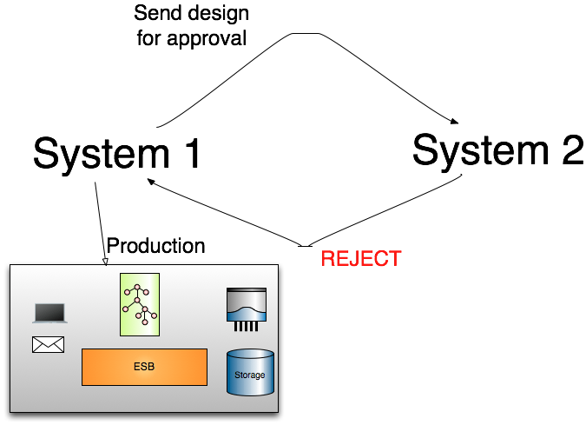

Slide 17
A day in the life of Systems 1 & 2
System 1
Developer with Cocktail Napkin
But I am building on Ruby on Rails, naw wait a sec Groovy on Grails
We are Agile
Requirements? No its user stories and test cases
We need to ship. Soon.
System 2
Where’s your risk assessment?
But will you use Trustworthy Computing?
Where’s the data classification?
Where is the end to end design?
I will schedule a pen test
Notes:
When you say I wish the devs did data classification or threat models, what you are really saying i s- i wish software was written with system two. Whether it should be or shouldn't be is an irrelevant question, its not written in system two, its written in system one. Your appsec plan has to factor this in.
fixes must be addressed in a systematic manner too. you cant slam a playbook of system two ideas and expect it all to work in a big bang. aim for a balance

Slide 18
System 2 Solutions
System 2
ISO 27001
Asset management
Identity Management, Provisioning
Role Based Access Control
Static Analysis

Slide 19
No Value w/o System 1 Implementation
System 1
System 2
ISO 27001
Asset management
Identity Management, Provisioning
Role Based Access Control
Static Analysis
Find & implement the links to System 1
Notes:
When you say I wish the devs did data classification or threat models, what you are really saying i s- i wish software was written with system two. Whether it should be or shouldn't be is an irrelevant question, its not written in system two, its written in system one. Your appsec plan has to factor this in.
fixes must be addressed in a systematic manner too. you cant slam a playbook of system two ideas and expect it all to work in a big bang. aim for a balance

Slide 20
Systems 1 & 2
System 1
Single Sign On
Role Based Access Control – Enforcement
System 2
Provisioning
Role Definition
Notes:
When you say I wish the devs did data classification or threat models, what you are really saying i s- i wish software was written with system two. Whether it should be or shouldn't be is an irrelevant question, its not written in system two, its written in system one. Your appsec plan has to factor this in.
fixes must be addressed in a systematic manner too. you cant slam a playbook of system two ideas and expect it all to work in a big bang. aim for a balance

Slide 21
A comment
It certainly helps to focus thinking about the payback (or lack thereof) we see in projects like some GRC 'automation' implementations (System 2 response paying lip service to System 1 interactions).
I also wonder whether a marker for robust, maturing infosec posture is that any measure introduced that delivers a System 1 outcome should have a System 2 corresponding capability performing analysis on effectiveness, efficiency, relevance.
- David Shaw
http://1raindrop.typepad.com/1_raindrop/2014/04/security-fast-and-slow.html

Slide 22

Developers need a hug

Slide 23
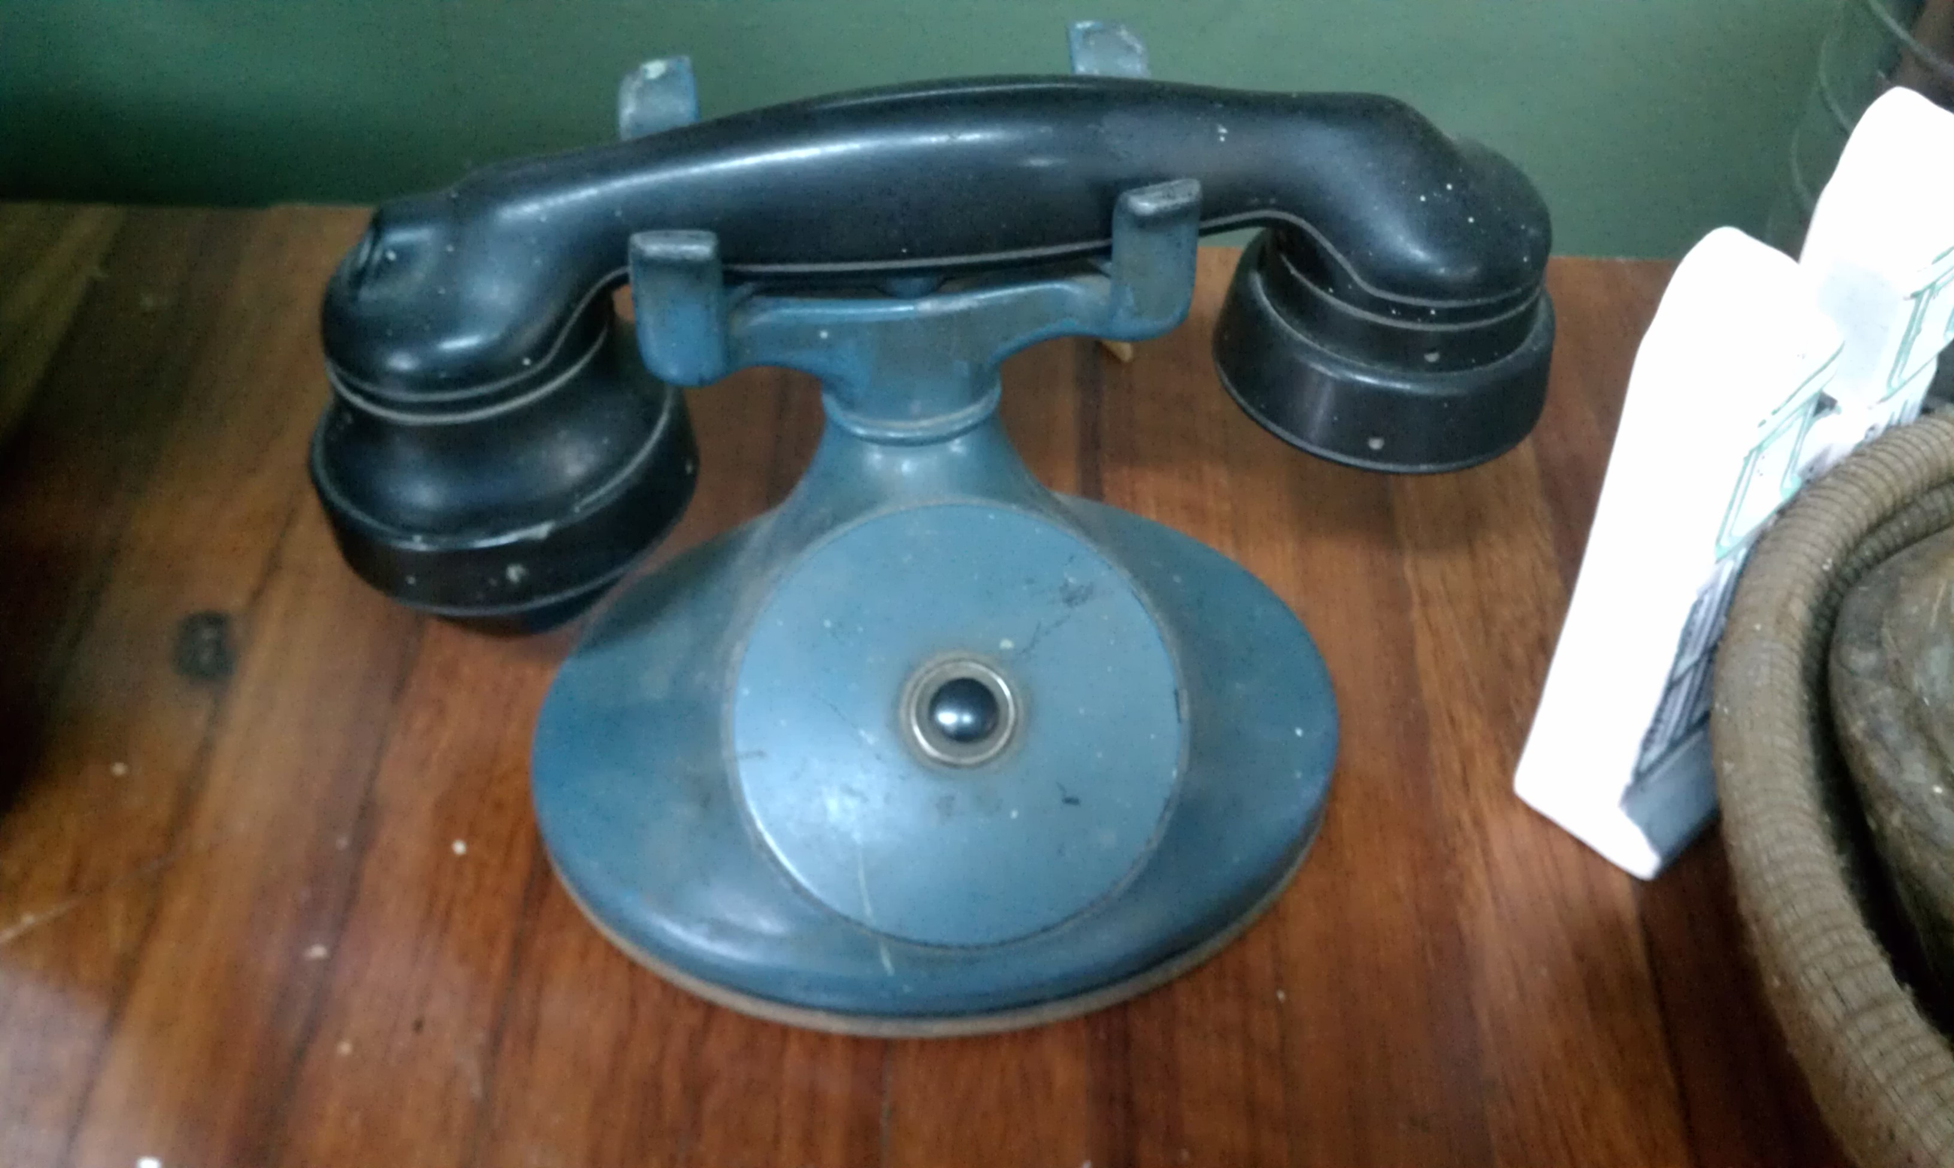
Keep it Simple

Slide 24

build your opponent a golden bridge to retreat across

Slide 25
Systems 1 & 2
System 1
Single Sign On
Role Based Access Control - Enforcement
Checklists
Vuln Scanners
WAF
Pattern recognition of partially complete list of bad input
ABAC Run time
Fine grained authorization and defensive coding
System 2
Provisioning
Role Definitions
SDL
Fuzzing
Security Architecture
Complete whitelist of all allowed behavior
ABAC policy development
Notes:
When you say I wish the devs did data classification or threat models, what you are really saying i s- i wish software was written with system two. Whether it should be or shouldn't be is an irrelevant question, its not written in system two, its written in system one. Your appsec plan has to factor this in.
fixes must be addressed in a systematic manner too. you cant slam a playbook of system two ideas and expect it all to work in a big bang. aim for a balance

Slide 26
Some Rules of Engagement
Have a balanced approach
You must always plan for System 1
How to get System 2 concept to System 1 “no thought required”
How to integrate
How to automate
No more than a few System 2s at a time
Ownership –
Let other departments own System 1
Never dump System 2 on someone else

Slide 27
Access in Maliceland

Slide 28


Access
Access in Maliceland

Slide 29

Access
Access in Maliceland
Malice

Slide 30

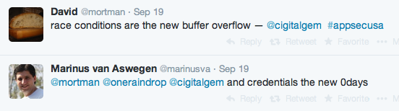
Why Identity Matters
“Corporate networks are like candy bars: hard on the outside, soft and chewy on the inside,”
-Rich Mogull, 2004

Slide 31
Design for Access vs Design for Malice
Design for Access
Authentication
Authorization
Provisioning
Access Policy
Design for Malice
Assume failure
Tokenization
Monitoring
Encryption
Limit attack surface
Intelligent response

Slide 32



Authentication
Something you know
Something you have
Something you are

Slide 33
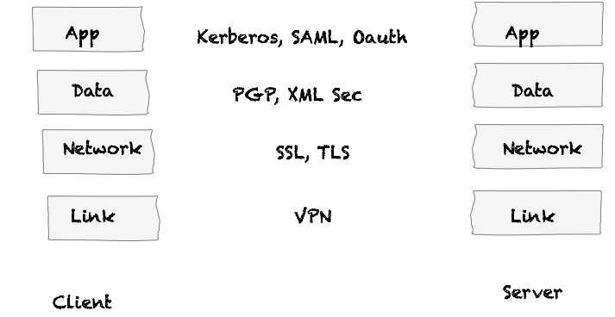
Security Protocols in Context

Slide 34
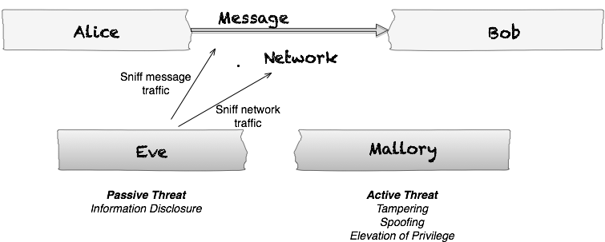
Alice & Bob Meet Eve & Mallory

Slide 35
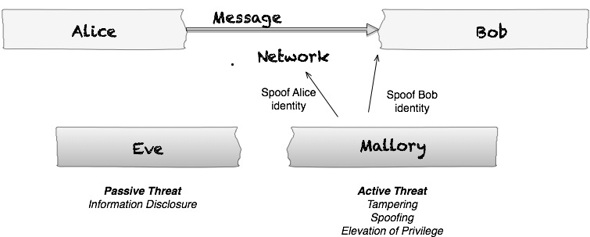
Alice & Bob Meet Eve & Mallory

Slide 36
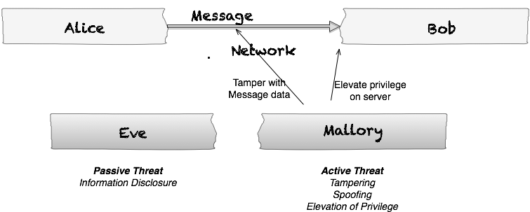
Alice & Bob Meet Eve & Mallory

Slide 37
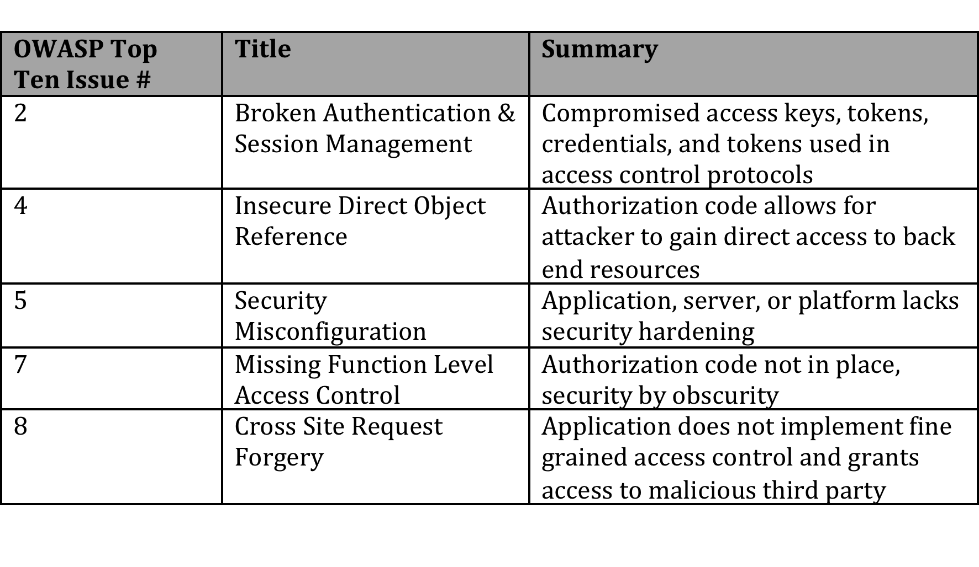
OWASP Top Ten

Slide 38



Access Control Model

Slide 39

Access Control Model

Slide 40

Access Control Model

Slide 41
Using Access Control Matrix
Problem description
WebGoat demo
XACML 101
XACML based solution

Slide 42
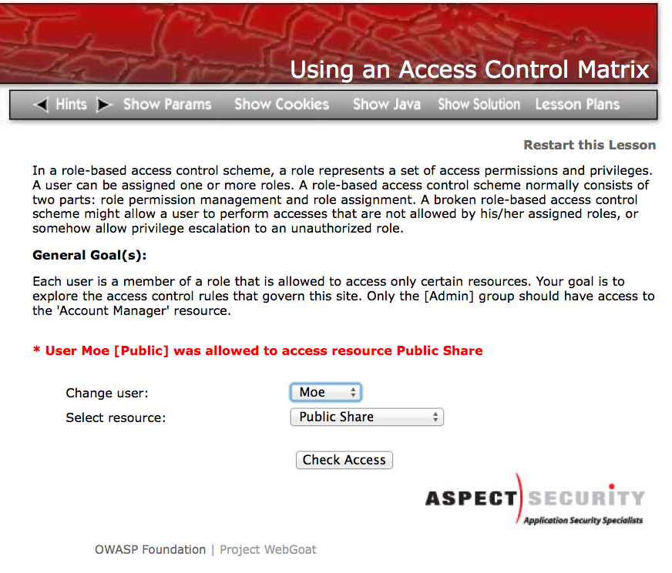
Using an Access Control Matrix

Slide 43
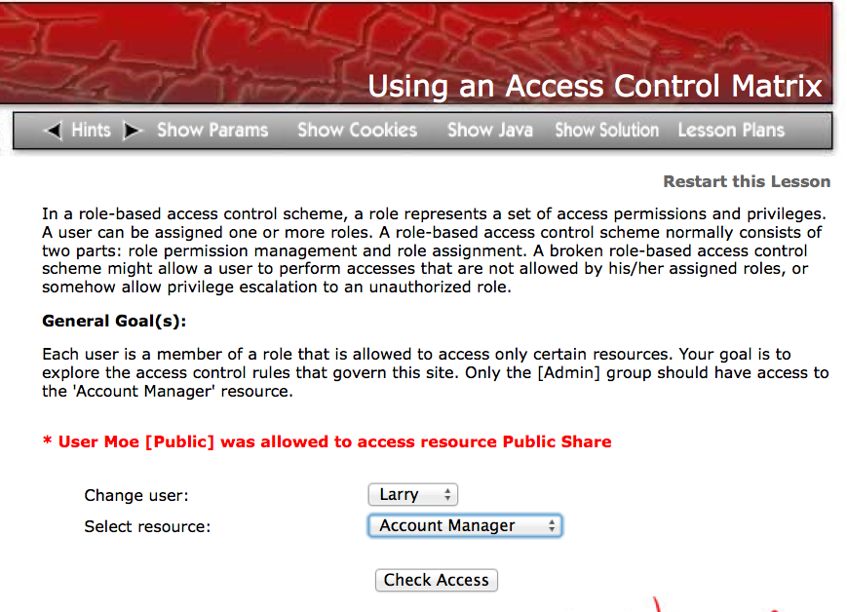
Using an Access Control Matrix

Slide 44
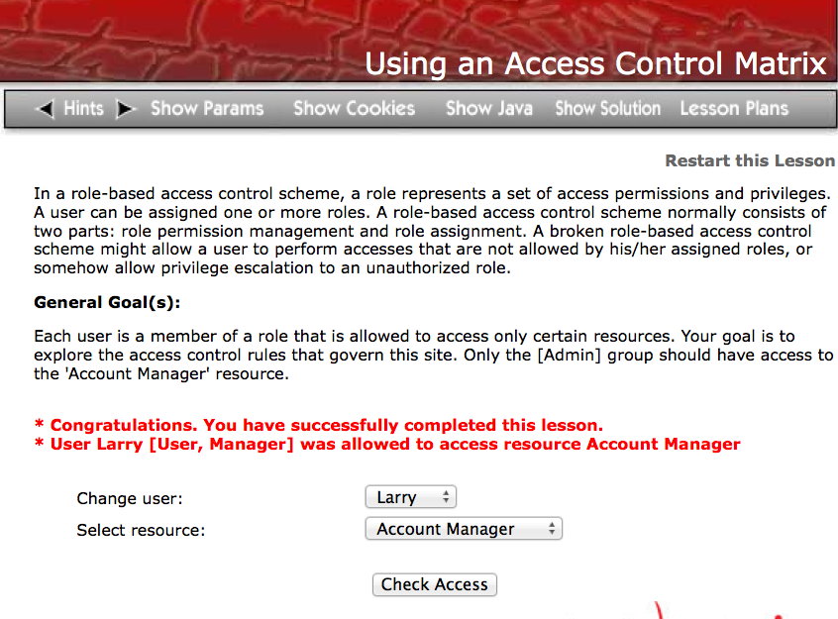
Using an Access Control Matrix

Slide 45
What is Attribute Based Access Control (ABAC)?
A mode of externalized authorization
Authorization policies/rules are managed in a centralized service (deployment can be centralized/distributed/hybrid)
Policies utilize attributes to describe specific access rules, which is why it is called attribute based access control
NIST Guide to Attribute Based Access Control (ABAC) Definition and Considerations
nvlpubs.nist.gov/nistpubs/specialpublications/NIST.sp.800-162.pdf

Slide 46
What is XACML?
eXtensible Access Control Markup Language
OASIS standard
V 3.0 approved in January 2013
V 1.0 approved in 2003 ( over 10 years ago!)
XACML core is expressed as
A specification document and
An XML schema
http://www.oasis-open.org/committees/xacml/

Slide 47
What’s in the XACML standard
XACML
Reference
Architecture
Policy Language
Request / Response Scheme
Profiles add functionality
REST
JSON
Export Control
IP Protection
Hierarchal Resources
Etc.

Slide 48
XACML Architecture
Enforce
Policy Enforcement Point
Decide
Policy Decision Point
Support
Policy Information Point
Policy Retrieval Point
Manage
Policy Administration Point

Slide 49
XACML Flow
Access Document #123
Access Document #123
Enforce
Policy Enforcement Point
Can Alice access Document #123?
Yes, Permit
Decide
Policy Decision Point
Retrieve user role, clearance and document classification
Support
Policy Information Point
Policy Retrieval Point
Load XACML policies
Manage
Policy Administration Point

Slide 50
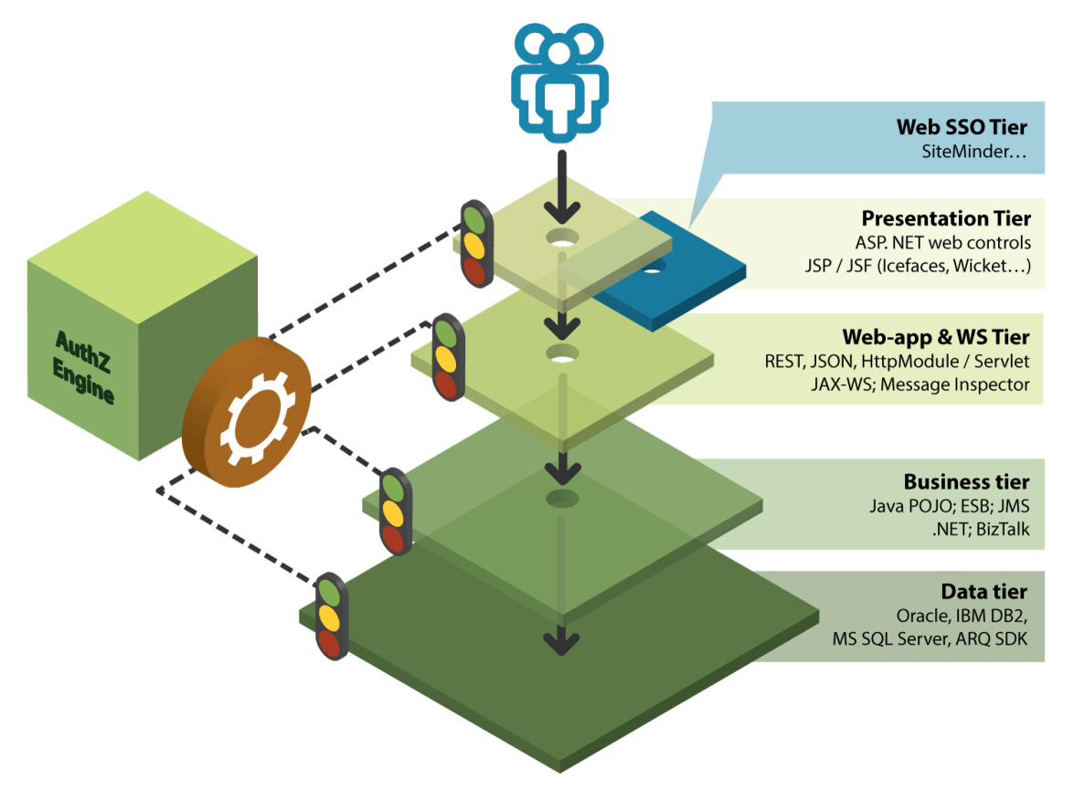
ABAC enables the Any-Depth Architecture

Slide 51
XACML Standard
XACML
Reference
Architecture
Policy Language
Request / Response Scheme

Slide 52
How does it work?
Subject |  | Action | Resource | Environment
A user … |  | … wants to do something … | … with an information asset … | … in a given context
Example:
An analyst… | …wants to view … |  | … market data related to a new share issue … | … via a secure channel after having been authenticated using the corporate smart card

Slide 53
XACML Standard
XACML
Reference
Architecture
Policy Language
Request / Response Scheme

Slide 54
Request/Response Scheme
Subject
Subject
Action
Action
XACML Response
Resource
Resource
Environment
Environment
XACML Policies

Slide 55
XACML-based solution for Using Access Control Matrix

Slide 56
JSON Injection
Problem description
WebGoat demo
XACML based solution

Slide 57
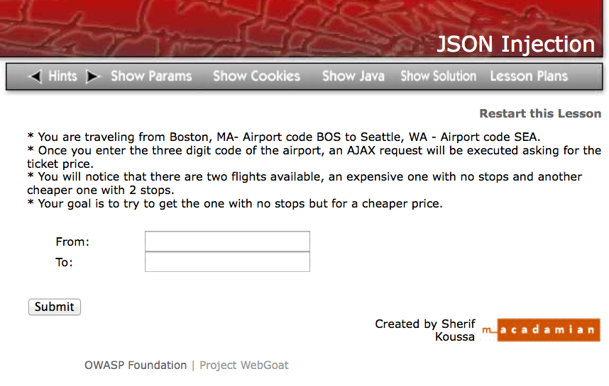
JSON Injection

Slide 58
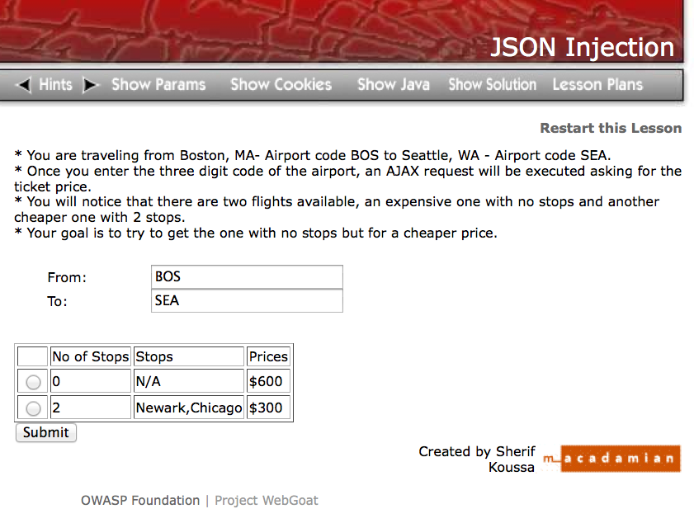
JSON Injection
Let’s get a $600 flight for $1

Slide 59
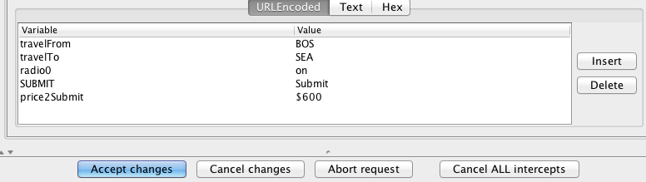
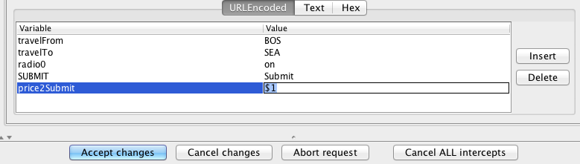
JSON Injection

Slide 60
XACML-based solution for JSON injection

Slide 61
Bypass path based access control scheme
Problem description
WebGoat demo
XACML based solution

Slide 62
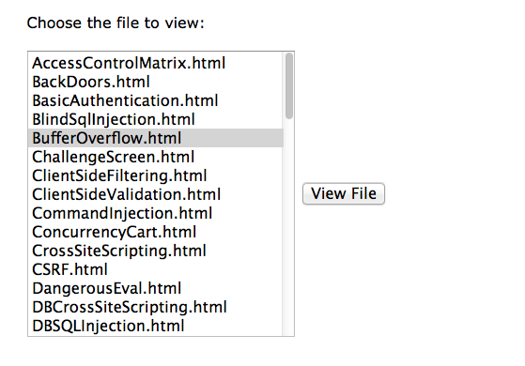
Bypass Path Based access control scheme
Direct Object reference allows attacker to swap selected file for different path+file and traverse file system

Slide 63
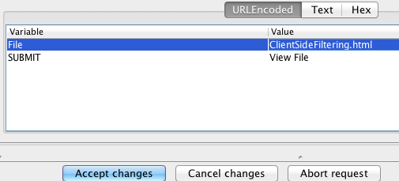
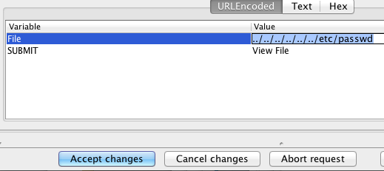
Bypass Path Based access control scheme
root:!:0:0::/:/usr/bin/ksh
daemon:!:1:1::/etc:
bin:!:2:2::/bin:
sys:!:3:3::/usr/sys:
adm:!:4:4::/var/adm:
uucp:!:5:5::/usr/lib/uucp:
guest:!:100:100::/home/
..

Slide 64
XACML-based solution for Path based access control scheme

Slide 65
Forced Browsing
Problem description
WebGoat demo
XACML based solution

Slide 66
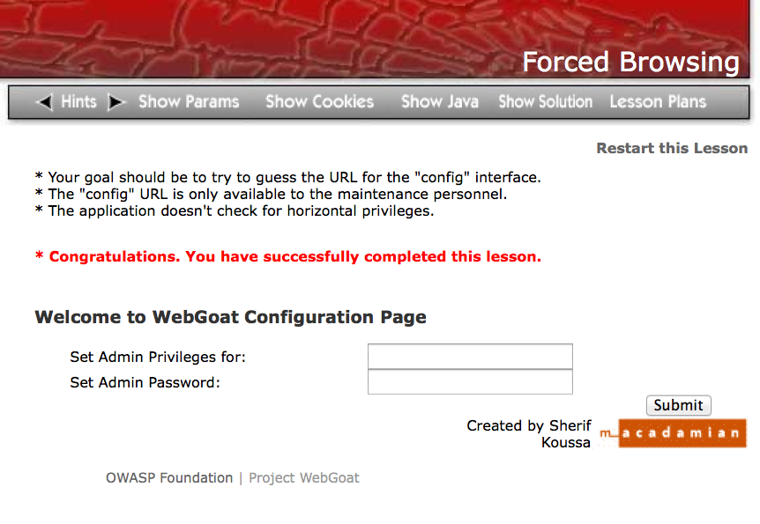
Forced Browsing
http://localhost:8080/WebGoat/conf
Swap URL to access
Admin Config page

Slide 67
XACML-based solution for Forced browsing

Slide 68
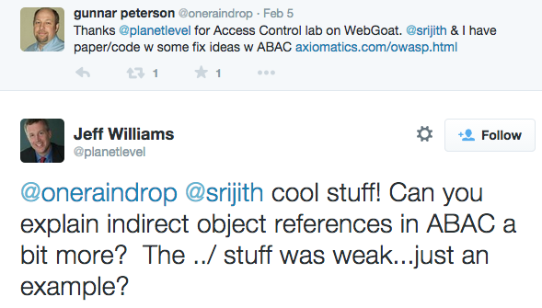
Indirect Object Reference solution

Slide 69
Indeed, “../” example of XACML policy was just an example
More elegant solution would be use of indirect object reference
Map each shareable object to reference value (simple integer, random characters)
Use this indirect references instead of the actual filename
Two possible XACML solutions
Minimal use of PDP
PDP has a mapping of who can access which indirect reference
App asks PDP if user is allowed to access specific indirect reference
PDP replies PERMIT/DENY and app performs the reference-to-object mapping to act on object
Using PDP to perform lookup
Add the reference map to a information point (PIP)
PDP responds with a PERMIT/DENY
It also replies with the mapped object’s identity as XACML Obligation
App interprets the response and value returned in the Obligation

Slide 70
Summary

Slide 71
A Path Towards More Effective Authorization
Get granular
Roles are great. Roles plus attributes are better
Use dynamic, fine grained attributes to drive access rules
Externalize authorization logic from code
Configure - don’t code authorization
Get defensive
Use ABAC to close out pernicious web vulnerabilities like Injection, Direct Object Reference, and Forced Browsing

Slide 72
Next Steps
Download and read the whitepaper
http://www.axiomatics.com/resources/case-studies-white-papers/84-getting-the-owasp-top-ten-right-with-dynamic-authorization.html
Download and run the code
Let us know how it works
Any other vulnerabilities you think ABAC can address?
http://www.axiomatics.com/owasp.html

Slide 73
Q&A

